Slide 1
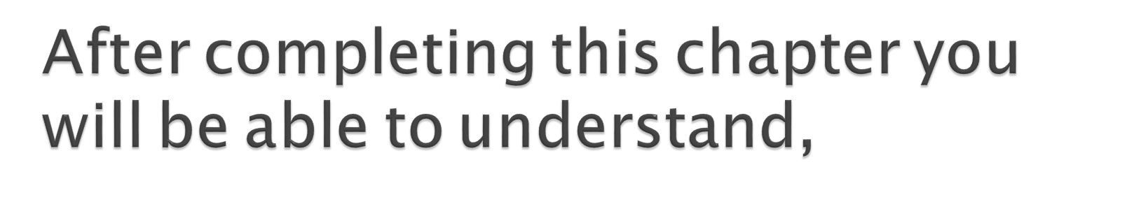
DDaass BBiilldd kkaannnn zzuurrzzeeiitt nniicchhtt aannggeezzeeiiggtt wweerrddeenn..
Evolution of Java.
Features of Java.
How to execute a Java program.

Slide 2
DDaass BBiilldd kkaannnn zzuurrzzeeiitt nniicchhtt aannggeezzeeiiggtt wweerrddeenn..
Java is an object oriented programming language. It has syntax similar to C and C++ languages, but has vastly improved features.
Java is platform independent.
Java platform provides a complete environment for application development on desktops and servers and for deployment in embedded environments.

Slide 3
DDaass BBiilldd kkaannnn zzuurrzzeeiitt nniicchhtt aannggeezzeeiiggtt wweerrddeenn..
Java, a Programming Language developed by Sun Micro System in the year 1991.
Java was developed by James Gosling, Patrick Naughton, Chirs Warth, Ed Frank and Mike Sheridon.
During the initial period Java was called as Oak (from 1991 to 1995).
Java’s direct predecessor are C and C++
Java developed using the syntax from C and object oriented concepts from C++.

Slide 4
DDaass BBiilldd kkaannnn zzuurrzzeeiitt nniicchhtt aannggeezzeeiiggtt wweerrddeenn..
Java is object oriented, it supports all the OOPS characteristics. This makes java application easy to develop and maintain.
Java is portable and platform independent - The feature Write-once-run- anywhere makes the java language portable provided that the system must have interpreter for the JVM.
Java is Secure, It does not use memory pointers explicitly. Security manager determines the accessibility options of a class like reading and writing a file to the local disk.
Java is robust , Java provides support for error checking at compile time and dynamic checking at runtime.
Java supports multi threading to enhance performance.
Java supports automatic memory management – Refers to memory allocation and reclaiming for Java objects.

Slide 5
DDaass BBiilldd kkaannnn zzuurrzzeeiitt nniicchhtt aannggeezzeeiiggtt wweerrddeenn..
.
The following are the Java frameworks,
Java SE - Java Platform, Standard Edition or Java SE is a widely used platform for programming in the Java language. This is the Java Platform used to deploy portable applications for general use. In practical terms, Java SE consists of a virtual machine, which is used to run Java programs, together with a set of libraries.
Library Examples: java.lang.*, java.net.*, jav.io.*, java.util.*.
Java EE - Java Platform, Enterprise Edition or Java EE is a widely used platform for server programming. The applications developed using JEE stack can be deployed in N tier fashion in appropriate application servers and remotely accessed.
Examples: EJB, Servlet, JSP, JSF , JMS etc.

Slide 6
DDaass BBiilldd kkaannnn zzuurrzzeeiitt nniicchhtt aannggeezzeeiiggtt wweerrddeenn..
.
Java ME - Java Platform, Micro Edition, or Java ME, is a Java platform designed for embedded systems such as mobile devices
, PDA etc. Target devices range from industrial controls to mobile phones and set-top boxes.
Examples: Connected Limited Device Configuration (CLDC), Mobile Information Device Profile (MIDP), Information Module Profile (IMP).

Slide 7

DDaass BBiilldd kkaannnn zzuurrzzeeiitt nniicchhtt aannggeezzeeiiggtt wweerrddeenn..
Java Code is compiled and converted to a byte code rather than a native code.
English is an language which can understood by many people across the world. Similarly byte code is a format that can be run in many platforms Unix, Windows, Linux and also irrespective of hardware's.

Slide 8
DDaass BBiilldd kkaannnn zzuurrzzeeiitt nniicchhtt aannggeezzeeiiggtt wweerrddeenn..
Das Bild kann zurzeit nicht angezeigt werden.
What is Java SDK?
SDK stands for Software Development Kit is a package used for developing java applications and converting the java code to Byte codes. The conversion is typically done using Java compilers.
What is JRE?
JRE stands for Java runtime environment is used for executing java applications . It converts the java byte code to the necessary native code based on the underlying platform.
There are different JRE versions for different platforms such as Linux, Windows, Unix etc.

Slide 9

JRE | Das Bild kann zurzeit nicht angezeigt werden. Java SDK
If you want java applications to be executed go for lighter versions JRE. For developing and running Java applications go for the bulkier Java SDK. 12
DDaass BBiilldd kkaannnn zzuurrzzeeiitt nniicchhtt aannggeezzeeiiggtt wweerrddeenn..
Das Bild kann zurzeit nicht angezeigt werden.

Slide 10

DDaass BBiilldd kkaannnn zzuurrzzeeiitt nniicchhtt aannggeezzeeiiggtt wweerrddeenn..
Java stand alone applications – These are typically GUI programs, command line java program that execute on a desktop computer and perform the desired functionality independently All they need is a JVM installed in desktop for execution.
Java web applications - These are typical applications that are built using combination of technologies such as EJB, JSF and servlets etc. These are deployed in an application server (or) web server. They are accessed using a web browser such as Fire Fox , IE. They are examples of N tier applications.

Slide 11
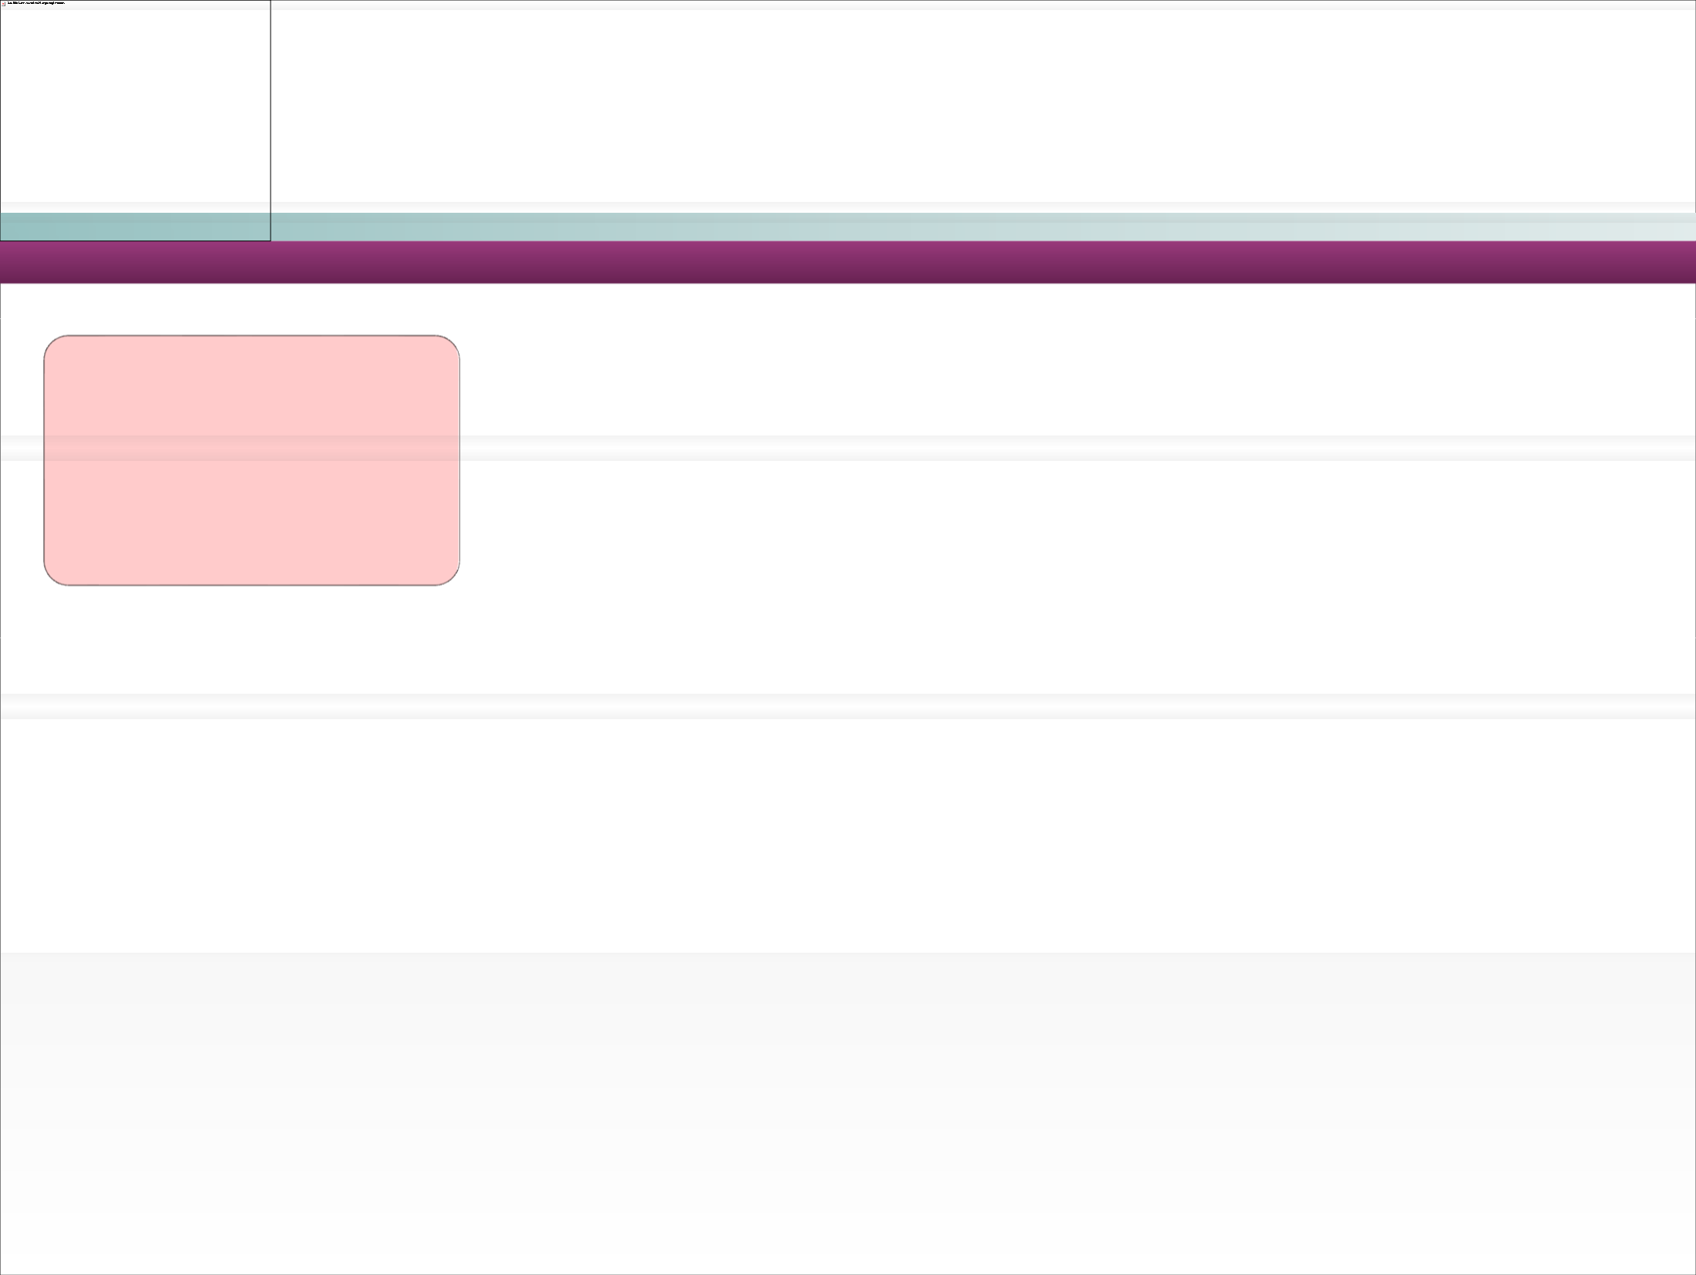


Develop the Java Program.
Compile the Java program into a class file
Run the program using the interpreter.
The Java compiler “javac” translates the Java program into classes with extension .class.
Class Files are in byte code format.
The Java interpreter “Java” converts the Java class byte codes into native code and executes it.
Java Program developed with “.java” extension

Slide 12
DDaass BBiilldd kkaannnn zzuurrzzeeiitt nniicchhtt aannggeezzeeiiggtt wweerrddeenn..
The components which makes Java program run are,
Java API’s
Java Class File
Java Virtual Machine (JVM) – Heart of Java technology.
What are Java API’s?
They are application interface which developer uses to develop java programs.
Example: System.out.println(“Hello World”);
Java developers uses System.out.println API to print messages on the console.

Slide 13

DDaass BBiilldd kkaannnn zzuurrzzeeiitt nniicchhtt aannggeezzeeiiggtt wweerrddeenn..
Loads class files using class loader
Executes the class file using the execution engine.
Das Bild kann zurzeit nicht angezeigt werden.

Slide 14
DDaass BBiilldd kkaannnn zzuurrzzeeiitt nniicchhtt aannggeezzeeiiggtt wweerrddeenn..
Java manages memory using garbage collector.
Double click the icon and view the animation in IE browser.
Refer to the “Resources” section of this Session for the attachment “How_Garbage_Collector_Works.swf”

Slide 15
DDaass BBiilldd kkaannnn zzuurrzzeeiitt nniicchhtt aannggeezzeeiiggtt wweerrddeenn..
Java Platform = Java virtual Machine + Java API
Example: Linux Platform = JVM for Linux + Java API for Linux.
In the below example the same “helloWorld” program is developed once and run in different operating systems. The execution engine specific to each OS will translate the byte code to respective OS native code.
HelloWorld.class HelloWorld.class HelloWorld.class
Linux
Windows
Unix
Class Loader
Class Loader
Class Loader
Execution Engine
Execution Engine
Execution Engine

Slide 16
DDaass BBiilldd kkaannnn zzuurrzzeeiitt nniicchhtt aannggeezzeeiiggtt wweerrddeenn..
Double click the icon and view the animation in IE browser.
Double click will not work in presentation mode.
Refer to the “Resources” section of this Session for the attachment “How_Java_Program_Runs.swf”

Slide 17
DDaass BBiilldd kkaannnn zzuurrzzeeiitt nniicchhtt aannggeezzeeiiggtt wweerrddeenn..
Create a folder “JavaWorks” in D or C drive.
Open notepad and type the following program in the notepad.
class HelloWorld{
public static void main(String []args){ System.out.println(“Hello World”);
}
}
Save the notepad file with the file name HelloWorld.java.
IMPORTANT NOTE: The file should be saved under the same name as of the class name.

Slide 18
DDaass BBiilldd kkaannnn zzuurrzzeeiitt nniicchhtt aannggeezzeeiiggtt wweerrddeenn..
Open a command window, type CMD in command window.
Set the path and class path variable.
What is Path?
Path represents the folders to be searched for running the java or javac commands.
Needed for compiling Java program.
How to set path: set path =c:\java 1.5\bin; %path%
Where %path% - To ensure that the new path is appended with existing path variables set.
NOTE: Assuming Java home is c:\java.

Slide 19
DDaass BBiilldd kkaannnn zzuurrzzeeiitt nniicchhtt aannggeezzeeiiggtt wweerrddeenn..
What is class path?
Class path is the path where the class and Java API’s are loaded. Needed for executing class files.
How class path is set: set classpath = c:\java\jre\lib; %classpath%;
Where %classpath% - To ensure that the new class path does not to override the existing class path variables set.
NOTE: Assuming Java home is c:\java.

Slide 20
DDaass BBiilldd kkaannnn zzuurrzzeeiitt nniicchhtt aannggeezzeeiiggtt wweerrddeenn..
Compile the program : In command prompt go to the folder “JavaWorks” and compile the program as follows.
javac HelloWorld.java
Where javac is the command line tool for compiling java programs.
Run the program: From the same folder run the program as follows, java HelloWorld
Where java is the command line tool used for running the program.
In the console you can see the message printed Hello World.
Change the message in the program as “Hello <Your Name>” and repeat steps
6 through 8 and see the program displaying a different output.

Slide 21
DDaass BBiilldd kkaannnn zzuurrzzeeiitt nniicchhtt aannggeezzeeiiggtt wweerrddeenn..
Java path can be set in the environment variables of system properties
Right click My Computer → Click Properties→ Click Advanced → Click Environment Variables → Click New(User Variables) → Add a new variable as
mentioned below
Das Bild kann zurzeit nicht angezeigt werden.
Variable Name = path
Variable Value = c:\java 1.5\bin; %path%
NOTE: Assuming Java home is c:\java.
This variable will be reflected across all the applications in the desk top.
On setting this the variable in environment parameter it gets reflected in all the command windows.

Slide 22
DDaass BBiilldd kkaannnn zzuurrzzeeiitt nniicchhtt aannggeezzeeiiggtt wweerrddeenn..
The main method is the starting point of any java application. Any java application to be executed using “Java” command needs a class with main method.
The application cannot run without a main method.
Once the Helloworld.class file is executed, the interpreter searches the main method and invokes it.
Syntax:
You will learn more about the access specifiers and method arguments in the subsequent sessions.
public static void main(String [] args)
{
// The program implementation
//goes here
}

Slide 23
DDaass BBiilldd kkaannnn zzuurrzzeeiitt nniicchhtt aannggeezzeeiiggtt wweerrddeenn..
In the program you would have noticed a statement
System.out.println(“Hello World”);
This is a java API used for printing messages on the console. This prints messages with a line break.
The other variant of this method is
System.out.print(“Hello World”); //This prints messages without a line
break.
Example:
System.out.print(“A”);
System.out.print(“B”);
System.out.print(“C”);
This displays the message “ABC” in the console.
This displays the message as F
G H
System.out.println(“F”); System.out.println(“G”); System.out.println(“H”);

Slide 24
DDaass BBiilldd kkaannnn zzuurrzzeeiitt nniicchhtt aannggeezzeeiiggtt wweerrddeenn..
Das Bild kann zurzeit nicht angezeigt werden.
Associates to reflect the following topics before proceeding.
What is the different between Java SDK and JRE?
What is Java ME & Java EE?
What are the types of Application Developed using Java?
Which is responsible for the memory management in Java?

Slide 25
DDaass BBiilldd kkaannnn zzuurrzzeeiitt nniicchhtt aannggeezzeeiiggtt wweerrddeenn..
Develop the following program using notepad,
Create a Java program with a main method and save it as “FirstProgram.java” in the “JavaWorks” Folder.
The Java program needs to print the following message (in brown & green color font) in the specified format in the console.
******** This is My First Java Program ********
********This is a demo on print ************
NOTE: The green and brown color text should printed using separate print statements.
Hint: Use print statement to display green and brown text message in the same line. Use println for introducing a line break.
Open a new command window and execute the program.
Compile the program

Slide 26
DDaass BBiilldd kkaannnn zzuurrzzeeiitt nniicchhtt aannggeezzeeiiggtt wweerrddeenn..
Classes are the fundamental building blocks of a Java program. Java application are built using one or more java classes, a class contains data and application business logics.
Data are represented as variables in classes.
Application business logic are implemented as methods in classes.
•A class is a blue print for making objects.
Classes Example: Employee, Department
NOTE:
A single physical .java file can have more than one classes.
The java file should be named after the class which is declared public.
There cannot be two classes defined as public in the same java file.

Slide 27
DDaass BBiilldd kkaannnn zzuurrzzeeiitt nniicchhtt aannggeezzeeiiggtt wweerrddeenn..
The Structure of the class is as follows,
class <Class Name>
{
This is the class declaration.
// The class implementation goes here
This is the class body implemented within the curly braces
}
The body of the class contains,
Variables – This is a container for storing class data.
Methods – Application behavior implemented and this changes the data (variables values).

Slide 28
DDaass BBiilldd kkaannnn zzuurrzzeeiitt nniicchhtt aannggeezzeeiiggtt wweerrddeenn..
class Employee
{
long empSalary=0; int empId=224566;
These are variables declared to store the employee id and the employee salary. The variable has a declaration and data type like integer (or) String.
void calculateSalary()
{
// logics of salary
//calculation goes in here empSalary= 10000;
This is the method definition.
The salary is stored as 10000 in the variable empSalary and printed in the console.
system.out.println(“Salary =“+empSalary);
}
}
NOTE: Java is case sensitive. For example, “Employee” and “employee“ are two different classes.

Slide 29
DDaass BBiilldd kkaannnn zzuurrzzeeiitt nniicchhtt aannggeezzeeiiggtt wweerrddeenn..
The Java API classes are referred to as inbuilt classes.
Inbuilt Classes
Example: String, System etc.
Java Classes
User Defined Classes
The Java classes developed by developer to develop the application are called User defined classes.

Slide 30
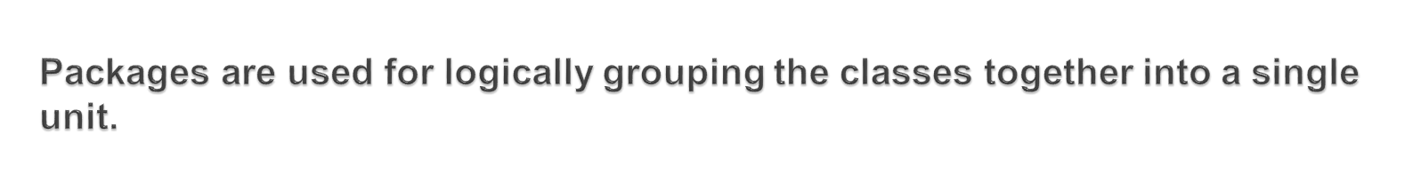
DDaass BBiilldd kkaannnn zzuurrzzeeiitt nniicchhtt aannggeezzeeiiggtt wweerrddeenn..
In the Java API, classes are grouped into packages.
Das Bild kann zurzeit nicht angezeigt werden.
Das Bild kann zurzeit nicht angezeigt werden.
Example:
USA
India
Both the apple looks similar, If you mix the apples you will end up with a confusion to differentiate the varieties. The box where they are placed helps us to differentiate them.
Similarly though the java classes have the same name using the packages (box) where they reside the classes can be differentiated and used.

Slide 31
DDaass BBiilldd kkaannnn zzuurrzzeeiitt nniicchhtt aannggeezzeeiiggtt wweerrddeenn..
Two different packages can have classes with the same name. If there is a naming clash, then classes can be accessed with their fully qualified name.
Packages provide a level of security, because you can restrict the class usage, which you develop in such a way that only the classes in the same package can access it.
Packages helps to organize classes into a folder structure which will be easy to maintain.

Slide 32
DDaass BBiilldd kkaannnn zzuurrzzeeiitt nniicchhtt aannggeezzeeiiggtt wweerrddeenn..
How to create a Package:
Use a “package” keyword to create packages.
Syntax:
package <package name>;
Where, package name is name of the package were the class should be place. This line should be placed as the first line of the program.
Example: package com.cognizant
NOTE: When compiling a java class with a package the compiler will create a The folder structure similar to the package defined.
Example: A java file Book.java under com.cognizant. package after compilation will generate a Book.class under com→cognizant folder.

Slide 33
DDaass BBiilldd kkaannnn zzuurrzzeeiitt nniicchhtt aannggeezzeeiiggtt wweerrddeenn..
How to import a Package:
Use “import” keyword to import a package.
Java includes the import statement to bring certain classes, or entire packages, into visibility.
Syntax:
import <package-name>.<class-name>;
(or)
import <package-name>.*;
Where, package- name and class-name is name of the package and class to be imported respectively. The second * option imports all the classes under the specified package. This line should be placed as the second line of the program ie. after package definition.
Example: import com.cognizant.Book; (or) import com.cognizant.*

Slide 34
DDaass BBiilldd kkaannnn zzuurrzzeeiitt nniicchhtt aannggeezzeeiiggtt wweerrddeenn..
package com.cognizant.books; public class Book{
void displayName()
{
System.out.println(“Java Book”);
}
}
package com.cognizant.libraries; import com.cognizant.books.Book; class Library{
public static void main(String args[])
{
Book book = new Book(); book.displayName();
}
}
How it Works?
The class book will be defined inside package “com.cognizant.books”.
For the Library class to use the Book Class it needs to import the Book class as “import com.cognizant.books.Book;”
•NOTE: Import not needed if the Library class is in the same package “com.cognizant.books”.

Slide 35
DDaass BBiilldd kkaannnn zzuurrzzeeiitt nniicchhtt aannggeezzeeiiggtt wweerrddeenn..
How to compile?
javac –d . Library.java
where –d denotes the destination directory for the compiled classes.
. Represents the current directory.
How to execute the class?
java com.cognizant.library.Library
The class needs to be executed using the absolute package name.

Slide 36
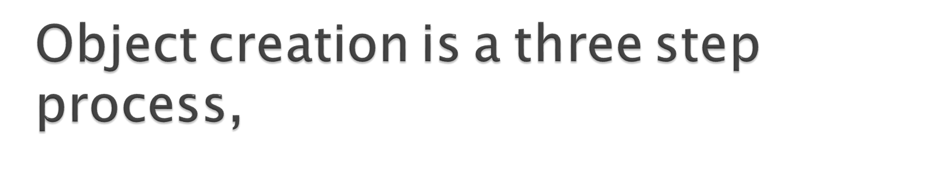
DDaass BBiilldd kkaannnn zzuurrzzeeiitt nniicchhtt aannggeezzeeiiggtt wweerrddeenn..
Declaration - Giving a name to the object to be created.
•
Instantiation - The new keyword and constructor creates a instance of the object.
Initialization - The values will be initialized using the constructor.
You will learn more about the constructors and objects in the next sessions.

Slide 37
DDaass BBiilldd kkaannnn zzuurrzzeeiitt nniicchhtt aannggeezzeeiiggtt wweerrddeenn..
This program creates a employee object and invokes the calculateSalary method on the object
class EmployeeProgram
{
public static void main (String args[])
{
Employee empObject =null;
Declares a employee object.
Instantiates and initialize the employee object using constructor.
Sets the employee salary as 20000.
empObject = new Employee();
empObject.empSalary = 20000;
empObject.calculateSalary();
Triggers the calculate salary method in the employee object.
}
}

Slide 38
DDaass BBiilldd kkaannnn zzuurrzzeeiitt nniicchhtt aannggeezzeeiiggtt wweerrddeenn..
1. Create a java class “Student” add a integer variable “registrationId”.
Create a method “displayReistrationId” which will print the “registrationId” of the student in the format
“The student registration id is <Registration Id>”
Create a java class “StudentMain” add a main method which will
  Create a object instance of the Student class
  Set the registration id to value “1290”
  Invoke the method ““displayReistrationId””.
The message needs to be displayed in the console.
Expected Output: “The student registration id is 1290”

Slide 39
DDaass BBiilldd kkaannnn zzuurrzzeeiitt nniicchhtt aannggeezzeeiiggtt wweerrddeenn..
Student.java
class Student{
public int registrationId = 0; void displayRegistrationId(){
System.out.println(“The student registration id is”+ registrationId );
}
StudentMain.java
class StudentMain{
public static void main(String args[]){ Student student =new Student(); student.registrationId= 1290; student.displayRegistrationId();
}
}

Slide 40
DDaass BBiilldd kkaannnn zzuurrzzeeiitt nniicchhtt aannggeezzeeiiggtt wweerrddeenn..
Das Bild kann zurzeit nicht angezeigt werden.
Associates to reflect the following topics before proceeding.
How can java class be logically grouped?
What are the benefits of java packages.
What is the keyword used for creating objects?.

Slide 41
DDaass BBiilldd kkaannnn zzuurrzzeeiitt nniicchhtt aannggeezzeeiiggtt wweerrddeenn..
1. Create a Class “Calculator” with two integer variables “operand 1”
& “operand 2”.
Create a method “displayOperand” and add the logic of displaying the variable values in the below format,
  “The value of operand 1 is <operand 1 Value>”
  “The value of operand 2 is <operand 2 Value>”
Create a main class “CalculatorExecutor” implement the following logic
  Set the value of “operand 1” as 89 and “operand 2” as 34.
  Invoke the method displayoperand.
The message should be displayed as mentioned in point # 2.

